Slide 1




How Crime Has Changed in St. Louis, MO
A study of how crime changed from 2021 to 2023
Team 8: Data Science Squad December 2024

Slide 2








Meet Team 8: Data Science Squad
Leslie
Bland
Luther Johnson
Cameron
Keplinger
Eshumael Manhanzva
Valarie
Miller
Saurabh
Singh
Tyler
Shubert
Teaching Assistant
Check out our cool shades!
Your Role

Slide 3




Project Overview
Curious about correlation of weather & crime
Selected St. Louis, MO
Among top 10 cities in US with highest crime rates
Too much to analyze weather & crime
Narrowed scope to crime in St. Louis
Last 3 years (2021-2023)
Further reduced to Top 5 crimes
Analyzed trends & patterns across 3 key dimensions
Time of day
Month-to-month
Seasonality
Discovered
Data can tell a different story
Use data to affect change

Slide 4



Our Goals
Understand Temporal Patterns
Identify how crime activity fluctuates during different times of the day
Detect Month-to-Month Trends
Determine how crime rates shift across months in the year
Assess Seasonal Effects
Examine how crime rates are influenced by seasonal changes over the three-year period

Slide 5

Data Collection & Exploration
St. Louis Metropolitan Police Department crime data
CSV was downloaded from St. Louis Crime Files
We focused on data fields reflecting crimes by:
Types
Times of Day
Monthly Rates
Seasonal Rates
Yearly Data Values
CSV file had 18,138 total records covering 2021-2023

Slide 6
Data Clean-up
Data Clean-up Overview
Determined Visual Studio data dependencies to review the Top 5 Crime types:
Property Damage : 1st Degree
Property Damage : 1st Degree (Motor Vehicle)
Stealing : Motor Vehicle
Stealing
Leaving Scene of Accident (Motor Vehicle)
Dropped irrelevant columns and crime types
Converted columns to proper date/time format
Dropped null/missing values from data

Slide 7

Research Approach
We used a Descriptive Analysis method
Summarized raw data to provide insights:
Averages
Counts
Trends
Answer “what happened” questions
Assumptions
Most crimes occur at night
Seasonality may have an impact on crime
Assaults & homicides are likely among the top 5 crime types

Slide 8
Research Questions
Have crime rates increased or decreased between 2021 and 2023?
What is the highest type of crime from 2021 – 2023?
Do crime patterns vary across the seasons?
How have trends for different crime types evolved?
Which times of year show the highest & lowest crime rates?
What time of day experiences the least crime?

Slide 9
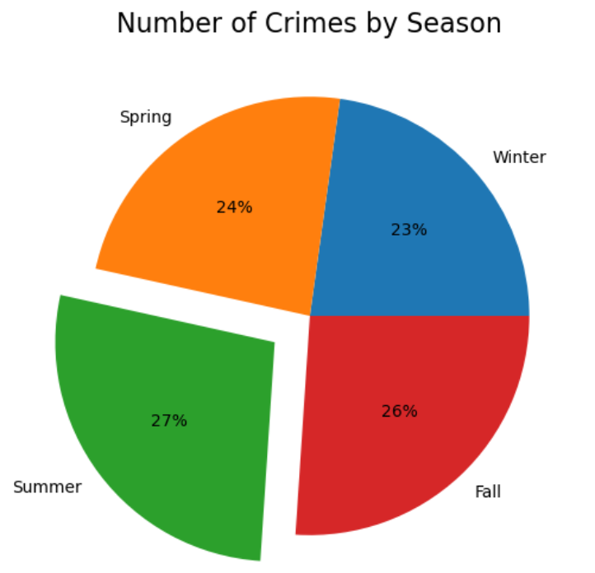
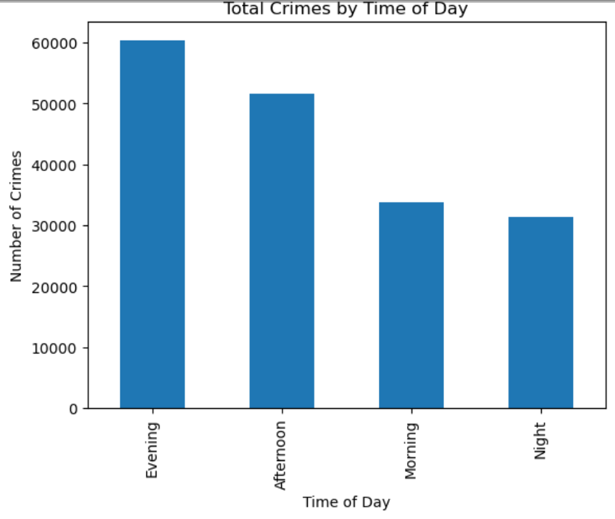
Analysis (Part 1)

Slide 10
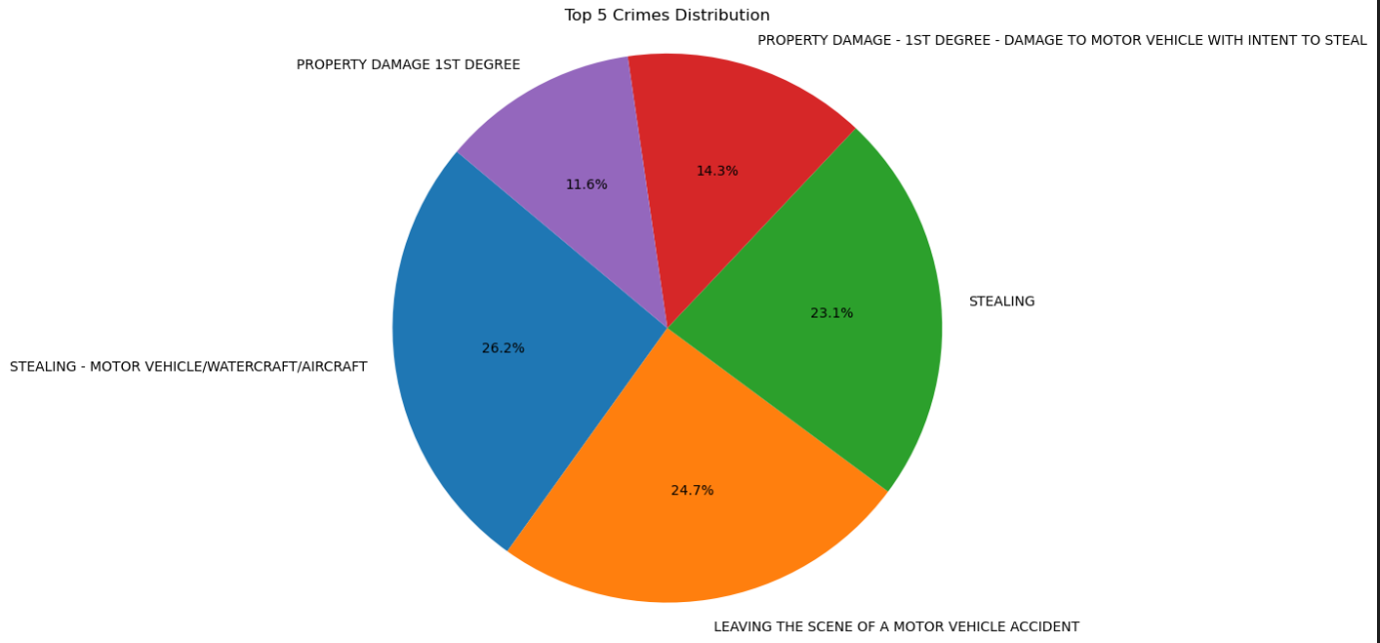
Analysis (Part 2)
LEAVING SCENE OF THE ACCIDENT (MOTOR VEHICLE)

Slide 11


Conclusions & Next Steps
Most crimes were committed in summer
Evenings had the most instances (5 – 9 pm) compared to Night (9 pm – 6 am)
Stealing motor vehicles (Auto/Air/Water) was most common crime
Homicide & assault were not in the top 5 crimes over the 3 years
Property damage occurred less than other crimes
Important to look at crime because you can help:
Improve public safety
Drive better allocation of resources
Support data-driven policy making
Next Steps
Overlay weather data
July 2021 & 2022 had the most crime
January had most crime in 2023
Recommend more police patrol during evening hours

Slide 12
DEMO! AFTERWARD YOU CAN ASK QUESTIONS WIN A PAIR OF VIRTUAL SHADES!
THANK YOU!

Slide 13
Appendix

Slide 14
Research Files
Cities in US with highest crime rates
https://getsafeandsound.com/blog/most-dangerous-city-in-america/#:~:text=1.,Memphis&text=Memphis%20has%20one%20of%20the,policing%20and%20community%20engagement%20initiatives
US News & World Report Real Estate Crime Rankings
https://realestate.usnews.com/places/rankings/most-dangerous-places
St. Louis, MO Metropolitan Police Department Data File
https://slmpd.org/stats/slmpd-downloadable-crime-files/?dpage=1

